Slide 1


Data Science Project – Olympic Games
Presented By:
Or Gvili
Given the data, can we predict whether an individual has the potential to win an Olympic medal?

Slide 2
Flow of the Project Process
The project is consisted of 6 primary steps
WOW Effects
Data Acquisition
EDA - Visualization
Using web crawling the extract the relevant data.
Handle hidden dropdowns and overlapping cookie elements.
Visualize the updated data.
Investigating distribution among different variables.
Analyze the data from a different perspective.
Research Question
Data Cleaning
Machine Learning
Given the data, can we predict whether an individual has the potential to win an Olympic medal?
Handling outliers
Handling NaN values
Handling duplicated records
Create a variety of models using our data.
Make predictions based on them.

Slide 3


Research Question
Given the data, can we predict whether an individual has the potential to win an Olympic medal?
Research Question
Data Acquisition
Data Cleaning
WOW Effects
EDA
Machine Learning

Slide 4

Data Acquisition
Obtaining the data was the most difficult part in the project.
I used with Selenium package to extract it.
Data Source: https://olympics.com (Crawling)
It is a dynamic webpage which contains:
Hidden Dropdowns & Nested Dynamic Pages
Overlapping Cookie Elements
DOM Inconsistency
Research Question
Data Acquisition
Data Cleaning
WOW Effects
EDA
Machine Learning

Slide 5

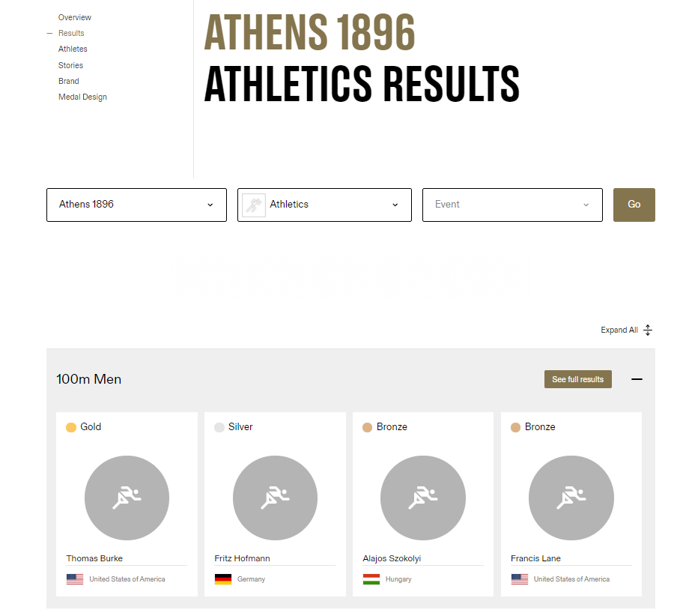
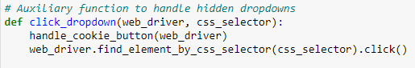
Data Acquisition – Hidden Dropdowns & Nested Dynamic Pages
Make use of XPATH & CSS Selectors
Research Question
Data Acquisition
Data Cleaning
WOW Effects
EDA
Machine Learning

Slide 6
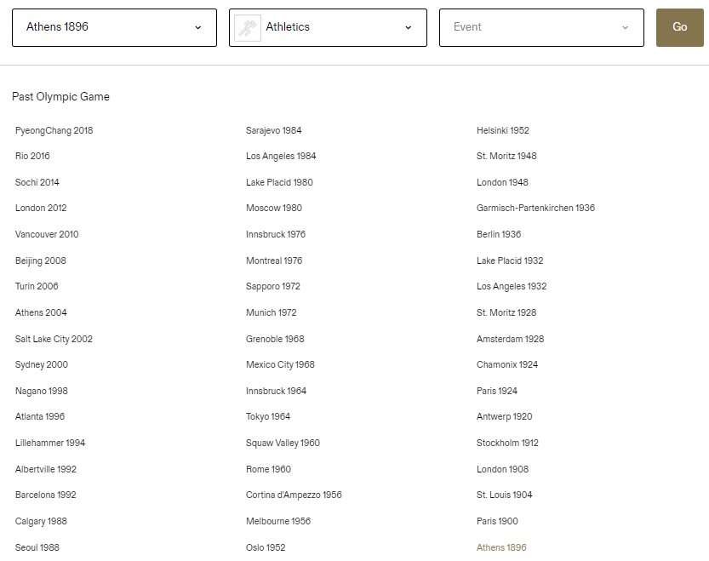

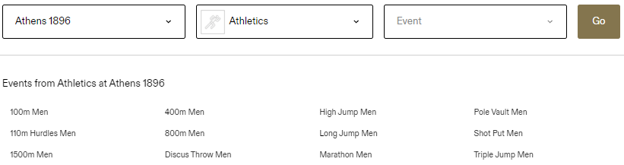
Every Olympic game has it own sports.
Moreover, every sport has it own events!
There must be noted that there is no consistency among not only every Olympic, but also among every sports!
Research Question
Data Acquisition
Data Cleaning
WOW Effects
EDA
Machine Learning

Slide 7
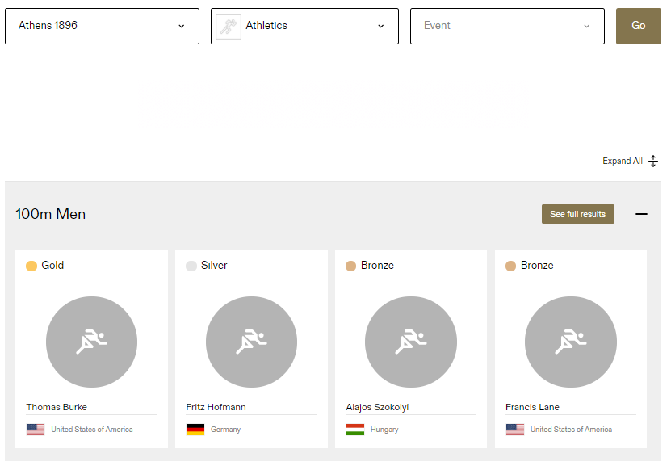
Another button
Research Question
Data Acquisition
Data Cleaning
WOW Effects
EDA
Machine Learning

Slide 8
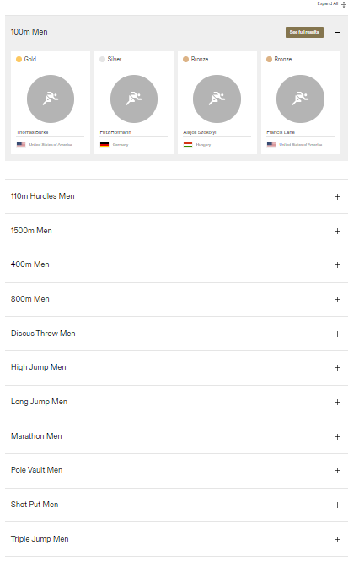
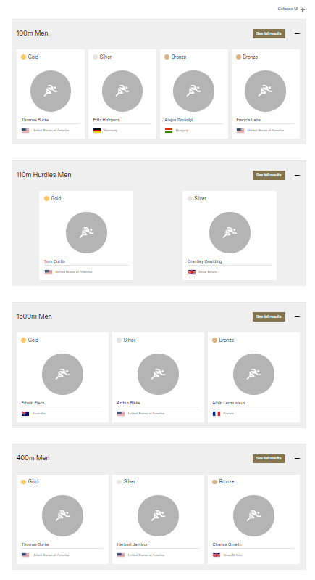
‘See Full Results’ Button
After Clicking
Research Question
Data Acquisition
Data Cleaning
WOW Effects
EDA
Machine Learning

Slide 9
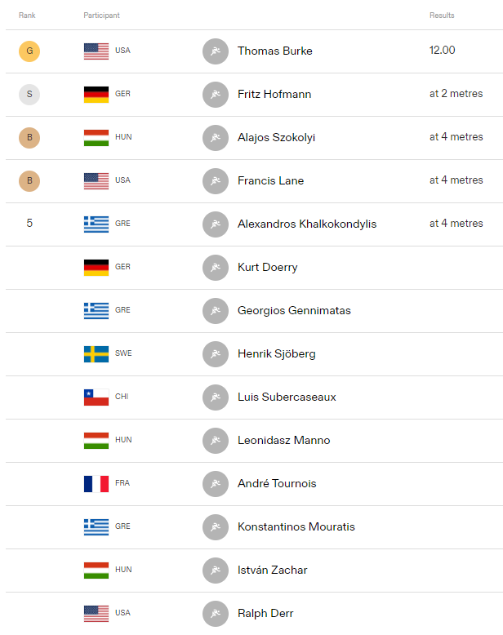
Every event have its own detailed page, obtained by clicking ‘See Full Results’ button
After Clicking
Research Question
Data Acquisition
Data Cleaning
WOW Effects
EDA
Machine Learning

Slide 10
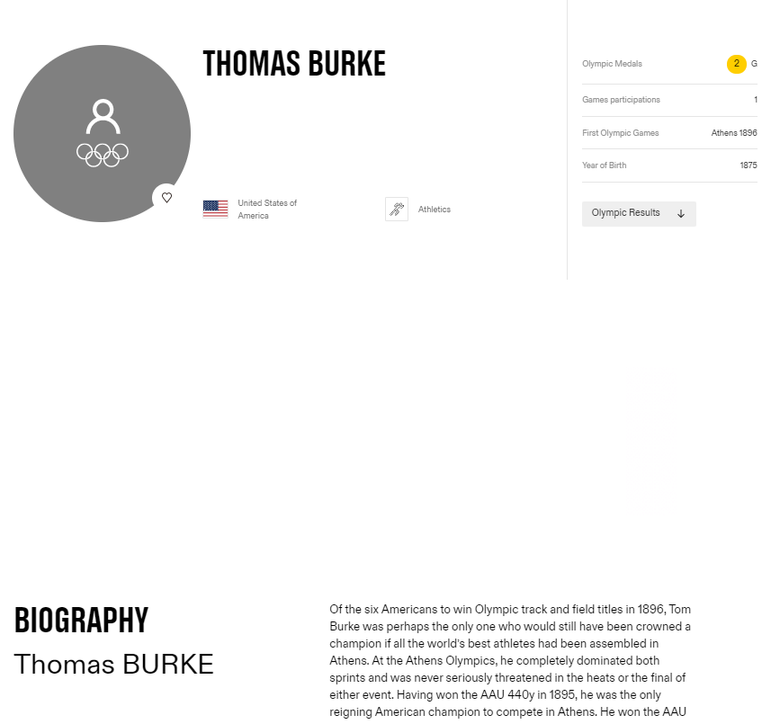
And finally, every participant have its own profile page…
Research Question
Data Acquisition
Data Cleaning
WOW Effects
EDA
Machine Learning

Slide 11
Data Acquisition – Overlapping Cookie Elements
At the bottom of each page, we can find:
In addition, every athlete profile page contains:
Research Question
Data Acquisition
Data Cleaning
WOW Effects
EDA
Machine Learning

Slide 12
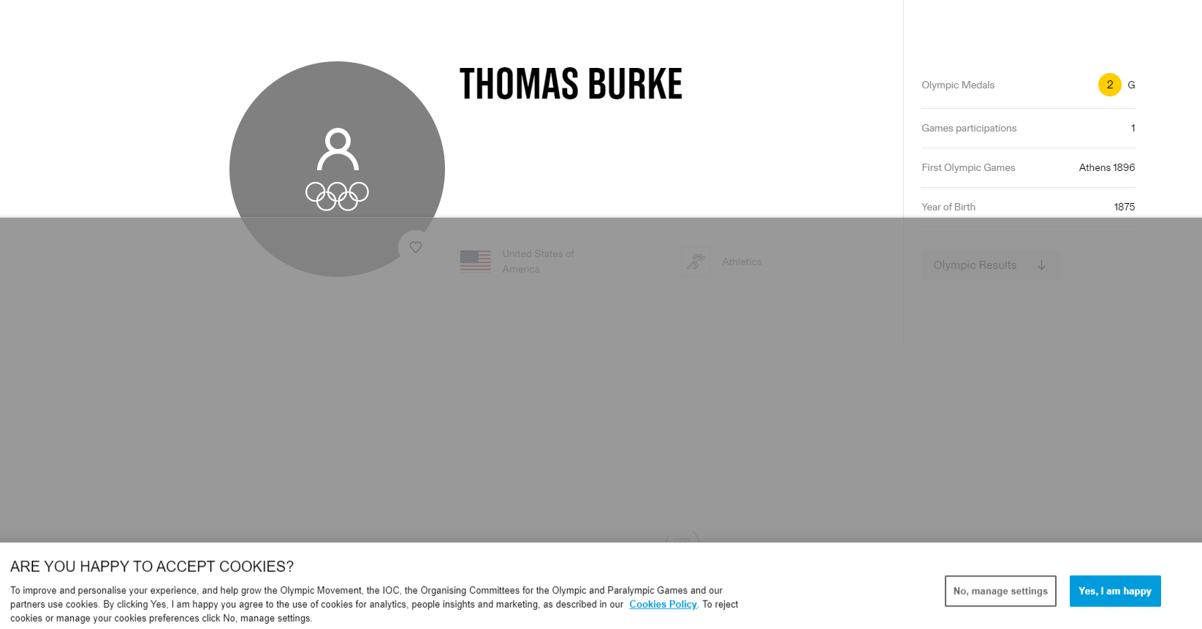
Data Acquisition – Overlapping Cookie Elements
Another Cookie window
Research Question
Data Acquisition
Data Cleaning
WOW Effects
EDA
Machine Learning

Slide 13
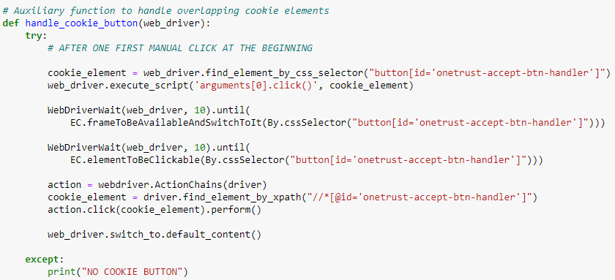
Data Acquisition – Overlapping Cookie Elements
Research Question
Data Acquisition
Data Cleaning
WOW Effects
EDA
Machine Learning

Slide 14
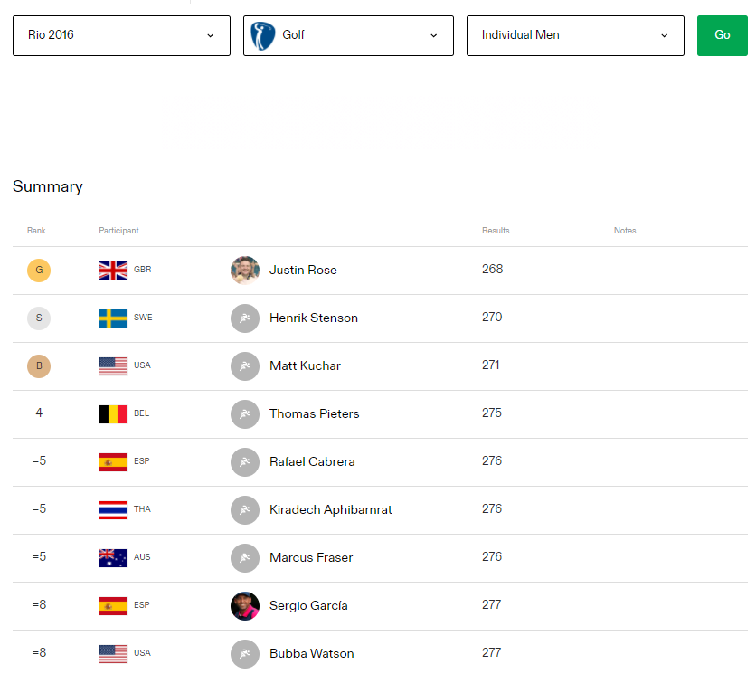
DOM Inconsistency
Many extreme cases have been considered.
The ideal medal table of a particular event looks like this:
Singles Event
Research Question
Data Acquisition
Data Cleaning
WOW Effects
EDA
Machine Learning

Slide 15
DOM Inconsistency
But, there are some other cases like:
Singles(like presented before)
Doubles
Team Events
Tie Situation
Research Question
Data Acquisition
Data Cleaning
WOW Effects
EDA
Machine Learning

Slide 16
DOM Inconsistency - Doubles
But, there are some other cases like:
Singles(presented before)
Doubles
Team Events
Tie Situation
Research Question
Data Acquisition
Data Cleaning
WOW Effects
EDA
Machine Learning

Slide 17
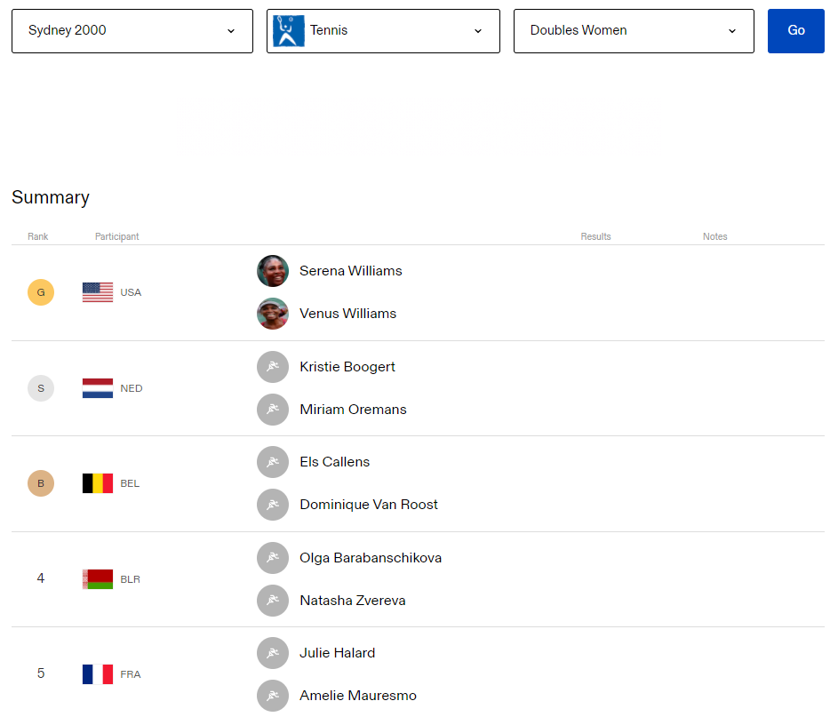
DOM Inconsistency - Doubles
But, there are some other cases like:
Singles(presented before)
Doubles
Team Events
Tie Situation
Unlike earlier, we can see that there are two elements under the same HTML element!
Research Question
Data Acquisition
Data Cleaning
WOW Effects
EDA
Machine Learning

Slide 18
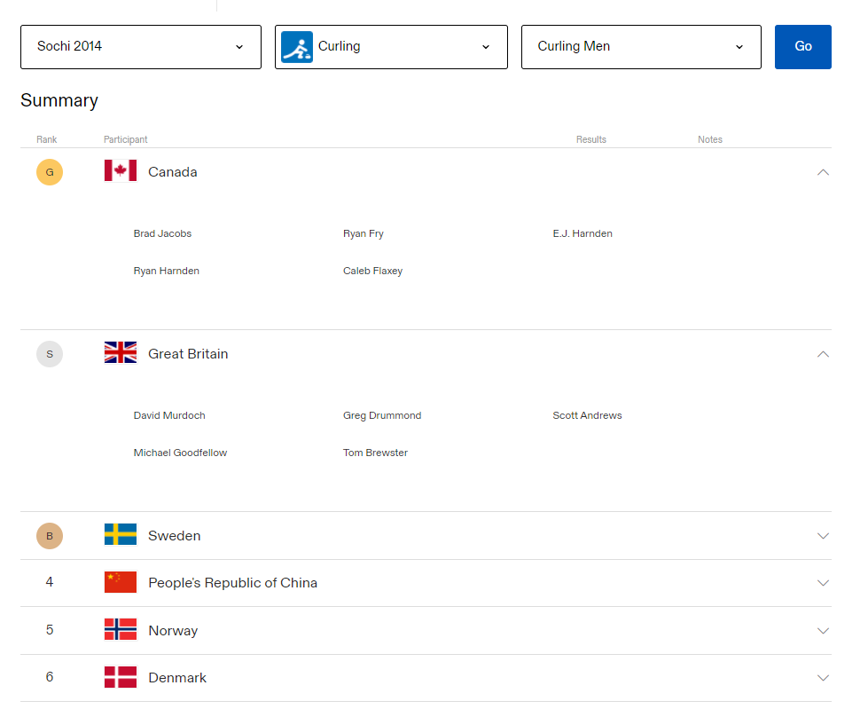
DOM Inconsistency – Team Events
Teams of 5
But, there are some other cases like:
Singles(presented before)
Doubles
Team Events
Tie Situation
In addition, there are cases which there 3 or more elements under the same HTML element!
In those cases, an expand button is added.
Research Question
Data Acquisition
Data Cleaning
WOW Effects
EDA
Machine Learning

Slide 19
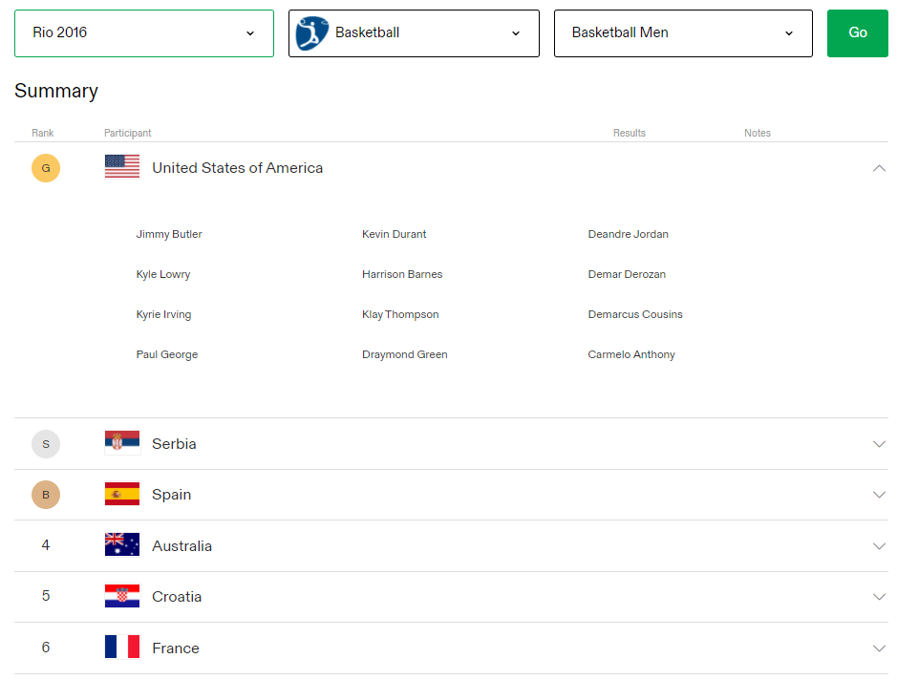
DOM Inconsistency – Team Events
Larger teams
But, there are some other cases like:
Singles(presented before)
Doubles
Team Events
Tie Situation
In addition, there are cases which there 3 or more elements under the same HTML element!
In those cases, an expand button is added.
Research Question
Data Acquisition
Data Cleaning
WOW Effects
EDA
Machine Learning

Slide 20
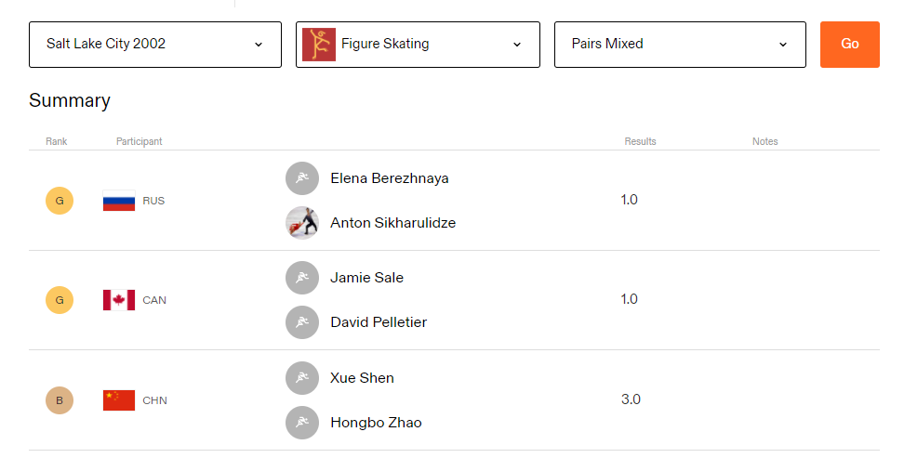
DOM Inconsistency – Tie Situation
But, there are some other cases like:
Singles(presented before)
Doubles
Team Events
Tie Situation
There are some events in which there has been a draw between the athletes.
In this case, 2 different HTML elements were allocated instead of 1 like before.
Research Question
Data Acquisition
Data Cleaning
WOW Effects
EDA
Machine Learning

Slide 21
Data Cleaning
Handling NaN values
Handling outliers
Handling duplicated records
Research Question
Data Acquisition
Data Cleaning
WOW Effects
EDA
Machine Learning

Slide 22
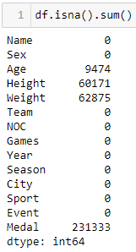
Data Cleaning – NaN Values
It can be noticed that the height and weight columns contain a huge part of missing values.
In such case, we will drop the missing values.
It should be noted that the absence of entries in the medal column denotes that no medal was obtained.
Research Question
Data Acquisition
Data Cleaning
WOW Effects
EDA
Machine Learning

Slide 23
Data Cleaning – NaN Values
However, in the age column we can notice that only a relatively small part of athletes have no age.
Therefore, we will fill those NaN values with the median age.
Research Question
Data Acquisition
Data Cleaning
WOW Effects
EDA
Machine Learning

Slide 24
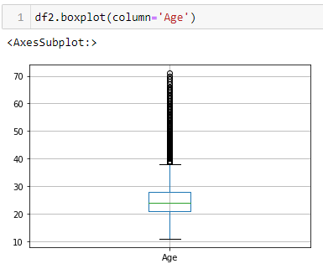
Data Cleaning - Outliers
Age is a primary factor that impacts outliers in the context of not only age, but also height and weight.
Research Question
Data Acquisition
Data Cleaning
WOW Effects
EDA
Machine Learning

Slide 25
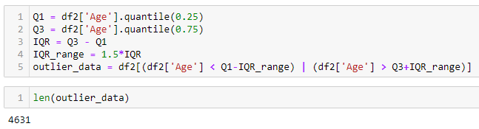
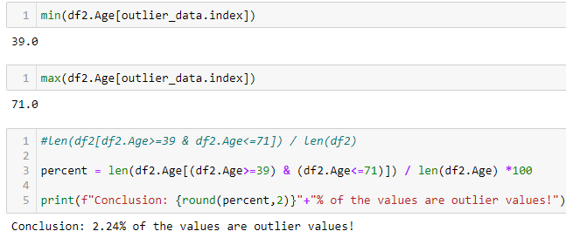
Data Cleaning - Outliers
I used IQR method to handle them.
Research Question
Data Acquisition
Data Cleaning
WOW Effects
EDA
Machine Learning

Slide 26
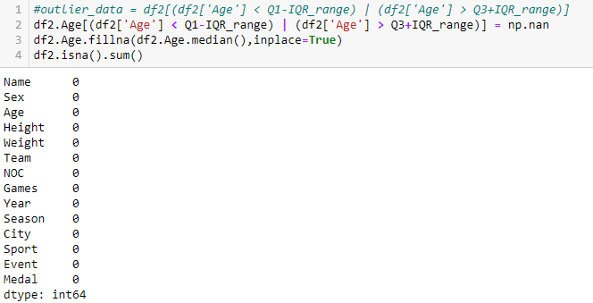
Data Cleaning - Outliers
Every outlier is replaced by the median
Research Question
Data Acquisition
Data Cleaning
WOW Effects
EDA
Machine Learning

Slide 27
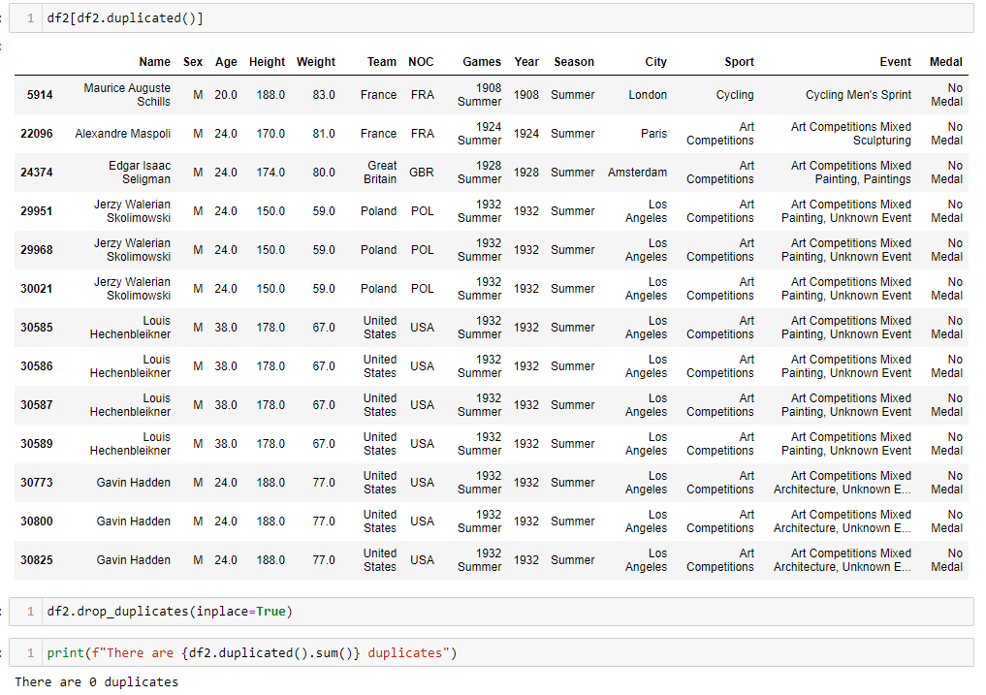
Data Cleaning – Duplicated Records
Trivially, I removed duplicated records…
Research Question
Data Acquisition
Data Cleaning
WOW Effects
EDA
Machine Learning

Slide 28

EDA
Visualize the updated data.
Investigating distribution among different variables.
Analyze the data from a different perspective.
Research Question
Data Acquisition
Data Cleaning
WOW Effects
EDA
Machine Learning

Slide 29
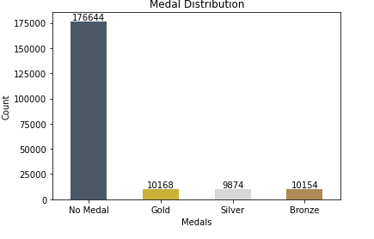
EDA – Medal Distribution
First, we will visualize the medal distribution
As we can see, it is confirmed that most athletes have not won a medal, of course...
Research Question
Data Acquisition
Data Cleaning
WOW Effects
EDA
Machine Learning

Slide 30
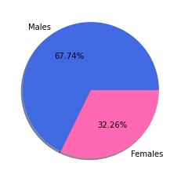
EDA – Gender Distribution
Next, we will visualize the gender distribution
We can observe that the males constitute over 2/3 of the participants!
Research Question
Data Acquisition
Data Cleaning
WOW Effects
EDA
Machine Learning

Slide 31
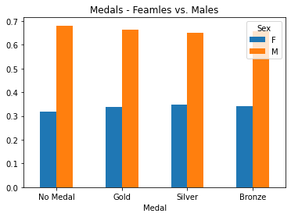
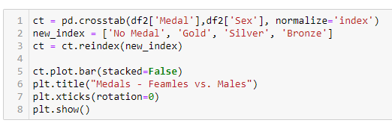
EDA – Further Analysis
In order to understand deeper, let us find out which gender has won the most medals
Cross Tabulation
We can notice that the males constitute around 70% of each Olympic medal.
But it can be explained since 2/3 of the participants are males!
Research Question
Data Acquisition
Data Cleaning
WOW Effects
EDA
Machine Learning

Slide 32
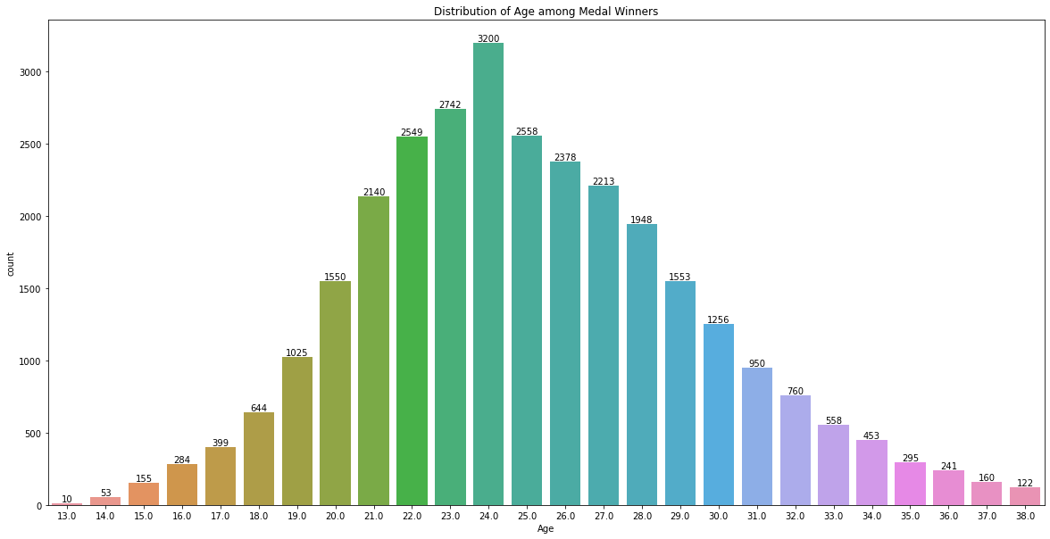
EDA – Age Distribution among Medal Winners
We can notice most of them are 22-26 years old.
We can observe that most of the winning athletes are 24 years old! Does it mean that the ideal age is 24?
Research Question
Data Acquisition
Data Cleaning
WOW Effects
EDA
Machine Learning

Slide 33
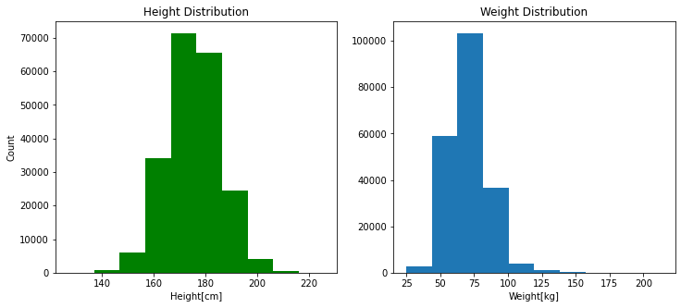
EDA – Weight and Height Analysis
Let us investigate this further, we will visualize the distributions of the height and weight
From the above graphs we can see that most of the winning athletes have weight of 60 to 75 kilograms, and height of 170 to 183 centimeters
Research Question
Data Acquisition
Data Cleaning
WOW Effects
EDA
Machine Learning

Slide 34
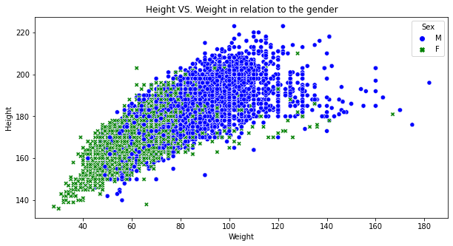
EDA – Further Analysis
After that we studied the height and weight distributions.
We will check the correlation of height vs. weight in relation to the gender:
The graph above shows that height and weight are highly correlated in both genders!
Research Question
Data Acquisition
Data Cleaning
WOW Effects
EDA
Machine Learning

Slide 35



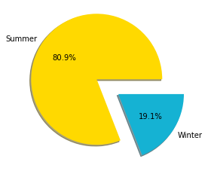
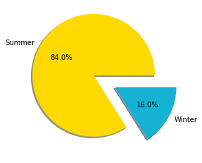
EDA – Season Analysis
Now, we want to investigate whether there the season influences the medal results.
For that, we will check if there is an even distribution between the seasons – summer & winter
And in particular, for those who won an Olympic medal:
Research Question
Data Acquisition
Data Cleaning
WOW Effects
EDA
Machine Learning

Slide 36
EDA – Season Analysis Cont.
We can see that in both cases, the winter season constitutes less then 20%! It means that in total, the vast majority of Olympic athletes, not only those who won a medal, but also the rest, have participated in summer Olympics rather than winter ones.
The number of competitors in summer Olympic games is at least 4 times bigger than the number of competitors in the winter ones.
Research Question
Data Acquisition
Data Cleaning
WOW Effects
EDA
Machine Learning

Slide 37
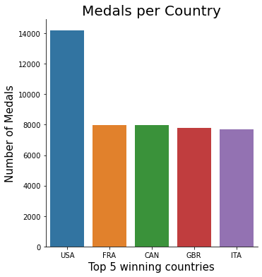
EDA – Top Countries
After those visualizations, now we are interested to find the countries with the most Olympic medals
As it may be noted, the United States is the only country with more than 14,000 Olympic medals!
Research Question
Data Acquisition
Data Cleaning
WOW Effects
EDA
Machine Learning

Slide 38
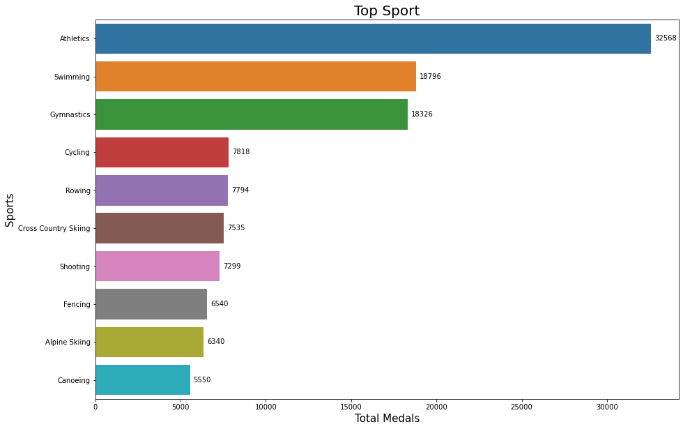
EDA – Top Sports
But which sport has produced the most Olympic medals thus far?
Research Question
Data Acquisition
Data Cleaning
WOW Effects
EDA
Machine Learning

Slide 39
EDA – Top Sports Cont.
We can see that Athletics, Swimming and Gymnastics are the top 3 sports!
Furthermore, it turns out that Athletics is by far the most popular sport!
Research Question
Data Acquisition
Data Cleaning
WOW Effects
EDA
Machine Learning

Slide 40
Machine Learning
Encoding categorial variables
Feature Selection
Ignore sports with insufficient amount of data
Binning numerical variables
Identifying the type of learning model and the problem
Creating Various Models & Prediction
Research Question
Data Acquisition
Data Cleaning
WOW Effects
EDA
Machine Learning

Slide 41
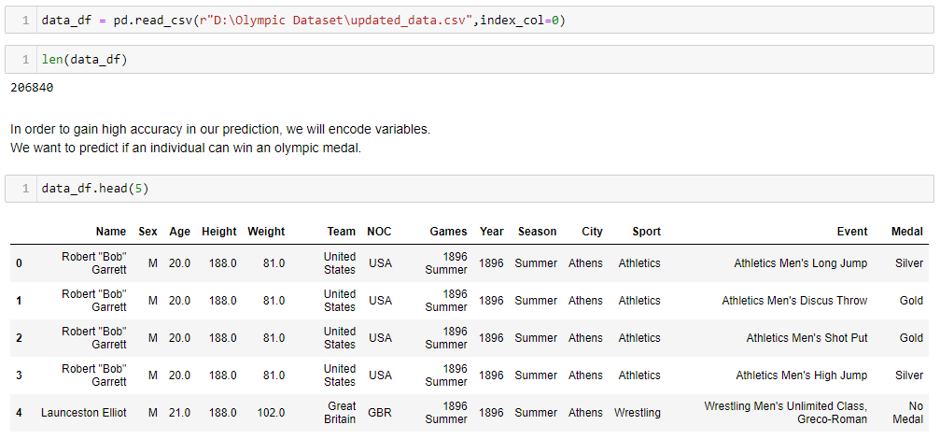
Machine Learning – Encoding Categorical Variables
The cleaned data looks like:
Research Question
Data Acquisition
Data Cleaning
WOW Effects
EDA
Machine Learning

Slide 42
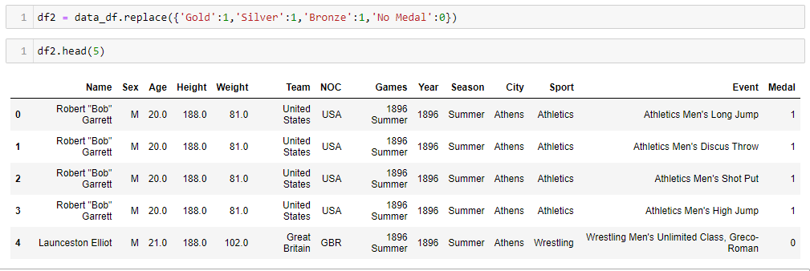
Machine Learning – Encoding Categorical Variables
First, we will encode the medals by:
Have medal = 1
Does not have medal = 0
Research Question
Data Acquisition
Data Cleaning
WOW Effects
EDA
Machine Learning

Slide 43
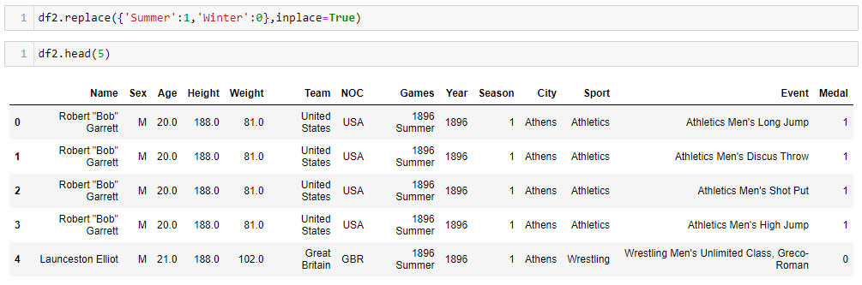
Machine Learning – Encoding Categorical Variables
Next, we will encode the seasons by:
Summer = 1
Winter = 0
Research Question
Data Acquisition
Data Cleaning
WOW Effects
EDA
Machine Learning

Slide 44
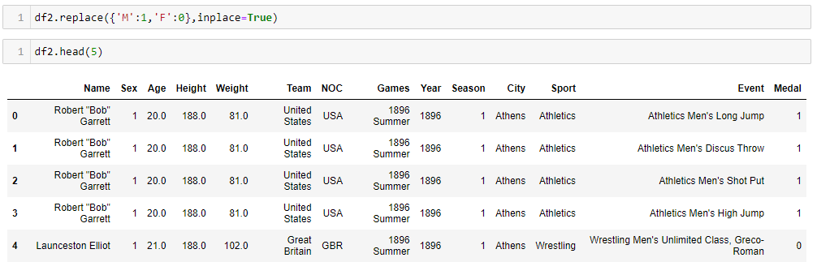
Machine Learning – Encoding Categorical Variables
Now, we will encode the genders by:
Male(M) = 1
Female(F) = 0
Research Question
Data Acquisition
Data Cleaning
WOW Effects
EDA
Machine Learning

Slide 45
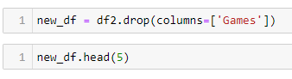
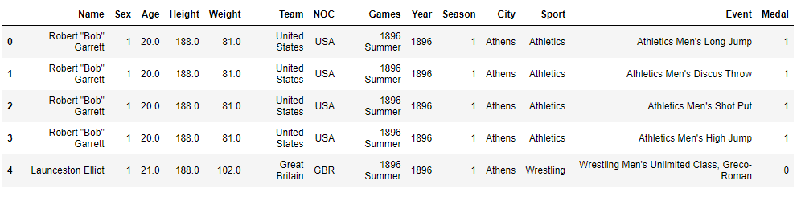
Machine Learning – Feature Selection
The games column is essentially consisted of both the year and the season columns.
Therefore, we will drop it.
Research Question
Data Acquisition
Data Cleaning
WOW Effects
EDA
Machine Learning

Slide 46
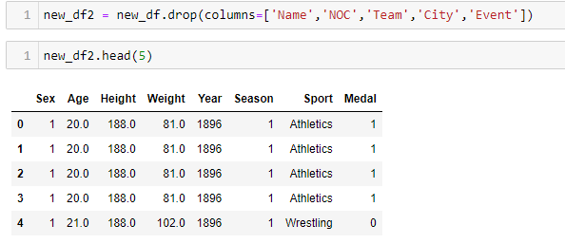
Machine Learning – Feature Selection
In addition, we will drop irrelevant columns.
After all, the athlete's performance in every Olympic game and every sport it includes is measured by its own abilities.
Research Question
Data Acquisition
Data Cleaning
WOW Effects
EDA
Machine Learning

Slide 47
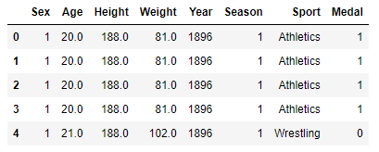
Machine Learning – Ignore sports with insufficient amount of data
At this point, the updated data looks like:
Research Question
Data Acquisition
Data Cleaning
WOW Effects
EDA
Machine Learning

Slide 48
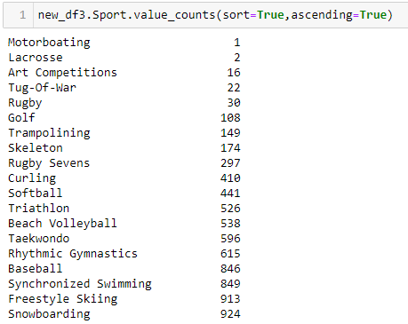
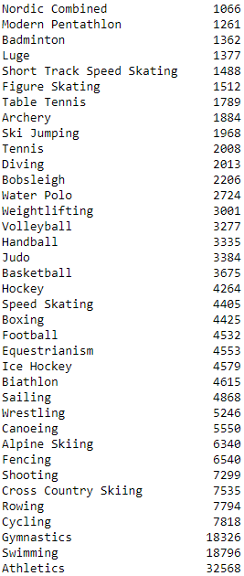
Machine Learning – Ignore sports with insufficient amount of data
A closer look at the sport column reveals that a portion of the sports have fewer than 1000 records!
Explanation:
Some of these sports have been discontinued, and others have a low participation rate.
Research Question
Data Acquisition
Data Cleaning
WOW Effects
EDA
Machine Learning

Slide 49
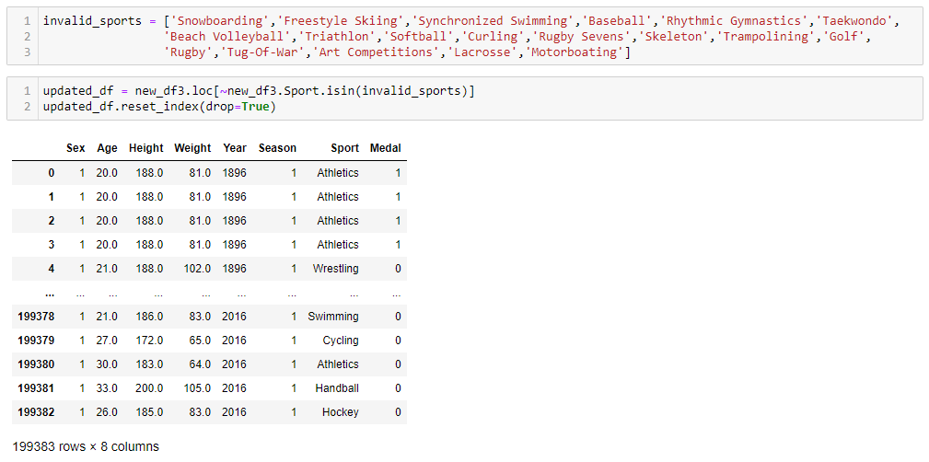
Machine Learning – Ignore events with insufficient amount of data
We will remove sports with less than 1000 records.
Research Question
Data Acquisition
Data Cleaning
WOW Effects
EDA
Machine Learning

Slide 50
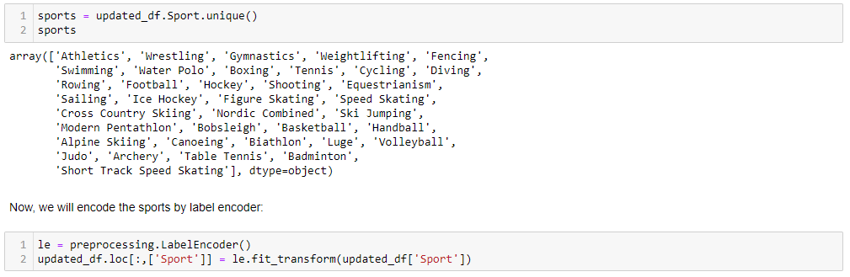
Machine Learning – Ignore sports with insufficient amount of data
All that is left for us to do is to encode the revised sports!
Research Question
Data Acquisition
Data Cleaning
WOW Effects
EDA
Machine Learning

Slide 51
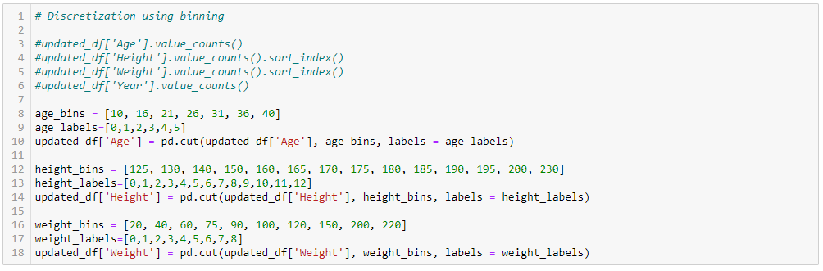
Machine Learning – Binning numerical variables
Research Question
Data Acquisition
Data Cleaning
WOW Effects
EDA
Machine Learning

Slide 52
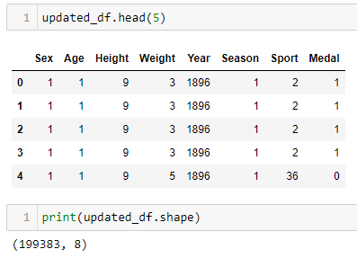
Machine Learning – Binning numerical variables
After that, our final dataframe looks like:
Research Question
Data Acquisition
Data Cleaning
WOW Effects
EDA
Machine Learning

Slide 53
Machine Learning – Identifying the type of learning model and the problem
What are we even trying to predict?
We are attempting to forecast whether or not an individual can win an Olympic medal based on his personal statistics and skills.
Now, what about the learning type of the model and the problem?
Essentially, our learning model is a supervised one.
Moreover, our problem is a classification problem since we are trying to predict a certain categorical variable value.
Research Question
Data Acquisition
Data Cleaning
WOW Effects
EDA
Machine Learning

Slide 54
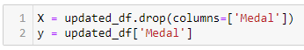
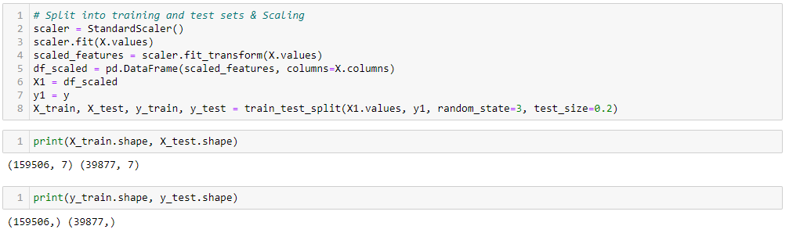
Machine Learning – Creating Various Models & Prediction
To begin, we'll divide the data into input variables (X) and output variable (y)
Now, we will do perform 2 actions:
Split the data into training and test sets
Scaling the data
Research Question
Data Acquisition
Data Cleaning
WOW Effects
EDA
Machine Learning

Slide 55
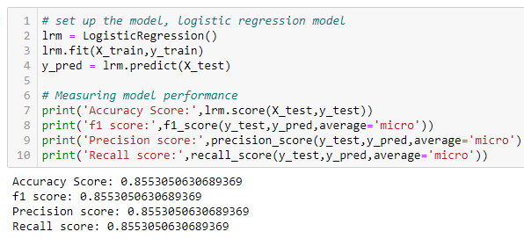


Machine Learning – Logistic Regression Model
First, we will use a logistic regression model.
After that, We will plot a confusion matrix:
We can see that the model above has not predicted even a single label as '1'
Research Question
Data Acquisition
Data Cleaning
WOW Effects
EDA
Machine Learning

Slide 56



Machine Learning – Decision Tree Classifier
Now, we will use a decision tree classifier
After that, We will plot again a confusion matrix:
We can see that this model performs better.
However, since the accuracy is 1, there might be an overfitting issue.
We will handle it by using Random Forest algorithm in the next slide!
Research Question
Data Acquisition
Data Cleaning
WOW Effects
EDA
Machine Learning

Slide 57



Machine Learning – Random Forest Classifier
Now, we will use a random forest classifier
After that, We will plot again a confusion matrix:
We can observe that this model produces great results.
Research Question
Data Acquisition
Data Cleaning
WOW Effects
EDA
Machine Learning

Slide 58



Machine Learning – Naïve Bayes Classifier
Lastly, we will use naïve bayes classifier
After that, We will plot again a confusion matrix:
We can observe that this model produces excellent outcomes either.
Research Question
Data Acquisition
Data Cleaning
WOW Effects
EDA
Machine Learning

Slide 59
Machine Learning – Conclusions
The best model was able to attain an approximate 85% success rate!
The 2 best models are - Random Forest &Gaussian Naïve Bayes.
Note that the Decision Tree model might has an overfitting issue.
Note that the Logistic Regression did not predict correctly even a single medalist
Research Question
Data Acquisition
Data Cleaning
WOW Effects
EDA
Machine Learning

Slide 60

WOW Effects
I made 2 WOW effects:
Forecasting whether or not I will win an Olympic medal in Tokyo in 2020 based on my stats
Coloring the world map
Research Question
Data Acquisition
Data Cleaning
WOW Effects
EDA
Machine Learning

Slide 61

WOW Effect #1
Let us insert my own encoded details:
Research Question
Data Acquisition
Data Cleaning
WOW Effects
EDA
Machine Learning

Slide 62

WOW Effect #1
It looks like this:
Research Question
Data Acquisition
Data Cleaning
WOW Effects
EDA
Machine Learning

Slide 63


WOW Effect #1
As previously stated, we will use our two best models for prediction – Random Forest & Naïve Bayes
Random Forest Classifier Predictions:
Naïve Bayes Classifier Predictions:
So, we can figure out after investigating our 2 top performencing models that:
The Random Forest Classifier predicted that I will not get even not a single medal.
On the opposite side, the Gaussian Naïve Bayes Model predicted that I have a potential to win an Olympic medal on 7 different sports!
Research Question
Data Acquisition
Data Cleaning
WOW Effects
EDA
Machine Learning

Slide 64



WOW Effect #1
Which sports are we talking about?
Research Question
Data Acquisition
Data Cleaning
WOW Effects
EDA
Machine Learning

Slide 65

WOW Effect #2
Research Question
Data Acquisition
Data Cleaning
WOW Effects
EDA
Machine Learning

Slide 66

WOW Effect #2
Research Question
Data Acquisition
Data Cleaning
WOW Effects
EDA
Machine Learning

Slide 67

WOW Effect #2
Note that at least 1 medal is needed in order to be colored!
Research Question
Data Acquisition
Data Cleaning
WOW Effects
EDA
Machine Learning

Slide 68




WOW Effect #2
Gold
Silver
Bronze
No Medal
Research Question
Data Acquisition
Data Cleaning
WOW Effects
EDA
Machine Learning

Slide 69

WOW Effect #2
Finally, we will visualize the number of the athletes per country by using the world map!
Research Question
Data Acquisition
Data Cleaning
WOW Effects
EDA
Machine Learning

Slide 70

THE END
Research Question
Data Acquisition
Data Cleaning
WOW Effects
EDA
Machine Learning

